Slide 1
How to write a scientific paper?
www.agrimetsoft.com
https://youtube.com/AgriMetSoft/

Slide 2
How to prepare a manuscript for international journals?
Steps to organizing your manuscript
Write the Abstract and Introduction
Prepare the figures and tables
Write the Material & Methods
Write up the Results
Write the Discussion
Write a clear Conclusion
2

Slide 3
Main concepts
Submit a paper
Which journal …?
Impact Factor & Q & citation
What is Scopus used for? How to Find Scopus Indexed Journals?
3

Slide 4
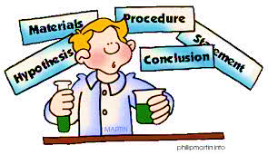
Key tips
Main steps for sending a paper
Open Access vs. Sub.
What is SJR and …?
GS
h & i10 indices
www.agrimetsoft.com
https://youtube.com/AgriMetSoft/

Slide 5
Please subscribe to our channel (https://youtube.com/AgriMetSoft/)
Like & do not forget to share it!!
Put your comments and questions below the video.
www.agrimetsoft.com
https://youtube.com/AgriMetSoft/
Notes:
Please hit the thumbs up button and don’t forget to subscribe !

Slide 6
?

